Slide 1

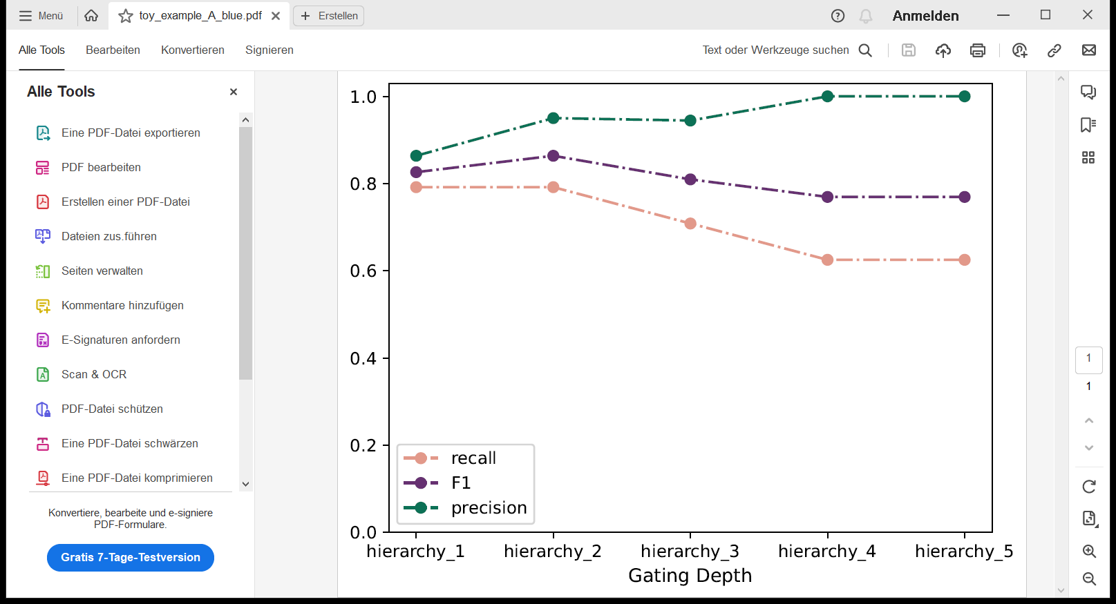
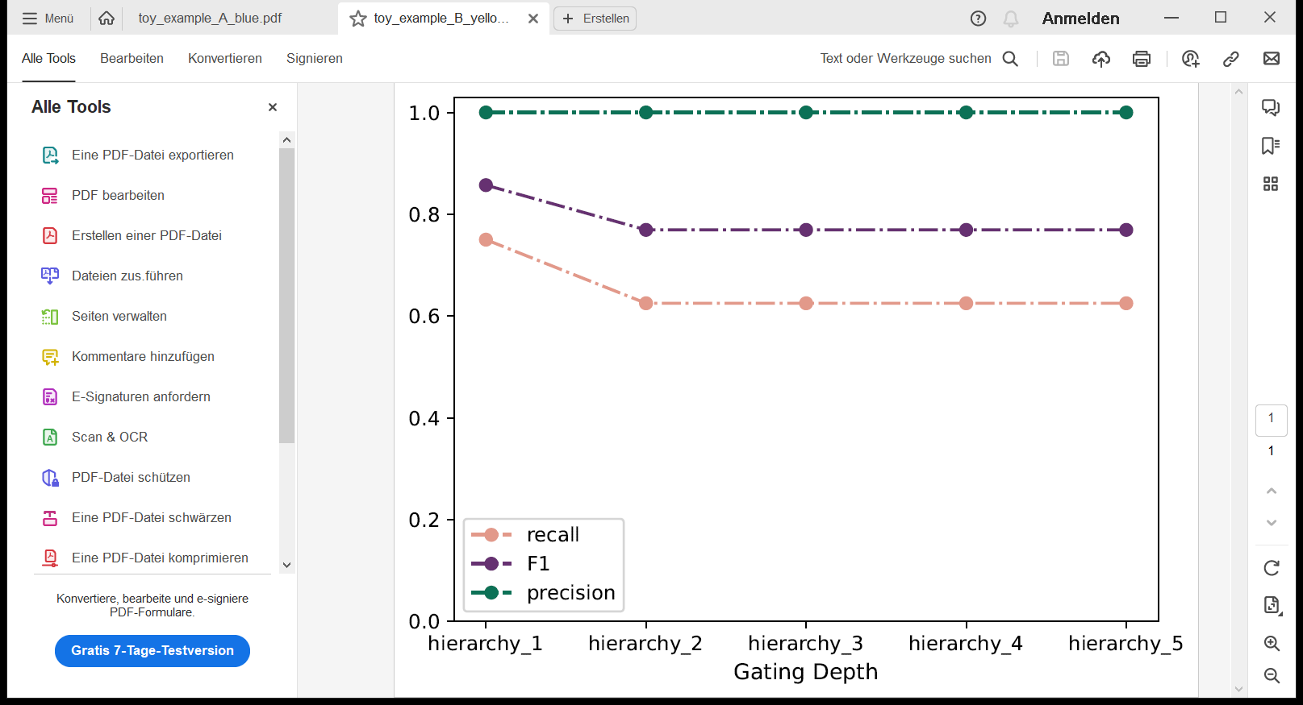

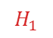
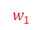
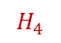
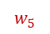
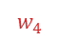
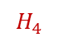

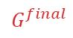
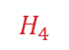
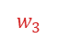


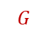
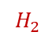
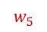
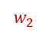

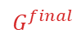
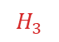
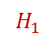
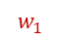
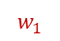
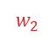
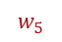

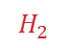

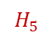

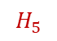



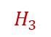
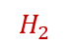
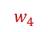
A
hierarchy 1
hierarchy 2
B
C
$$G$$
A
$$G$$
UMAP 2
A
marker 2
marker 4
D
E
hierarchy 1
UMAP 1
B
Convex Hull
marker 1
Convex Hull
marker 3
$$G^{final}$$
$$G^{final}$$
marker 4
$$G$$
marker 2
marker 4
Convex Hull
marker 1
B
marker 1
marker 3
marker 4
$$G^{final}$$
A
B
marker 1
C
$$H_{5}$$
backpropagation
backpropagation
$$H_{4}$$
$$w_{5}$$
$$w_{1}$$
$$H_{1}$$
$$H_{5}$$
$$H_{1}$$
$$w_{5}$$
$$w_{1}$$
$$G$$
$$H_{5}$$
$$w_{4}$$
$$w_{2}$$
$$G$$
$$H_{4}$$
$$w_{5}$$
$$w_{2}$$
$$H_{2}$$
$$H_{4}$$
$$w_{5}$$
$$H_{1}$$
marker j
$$H_{2}$$
marker j
$$w_{3}$$
marker j
$$w_{4}$$
$$w_{1}$$
$$G$$
$$H_{3}$$
$$w_{3}$$
$$H_{3}$$
$$H_{3}$$
$$w_{2}$$
$$H_{2}$$
$$w_{3}$$
marker i
marker i
marker i

Slide 2
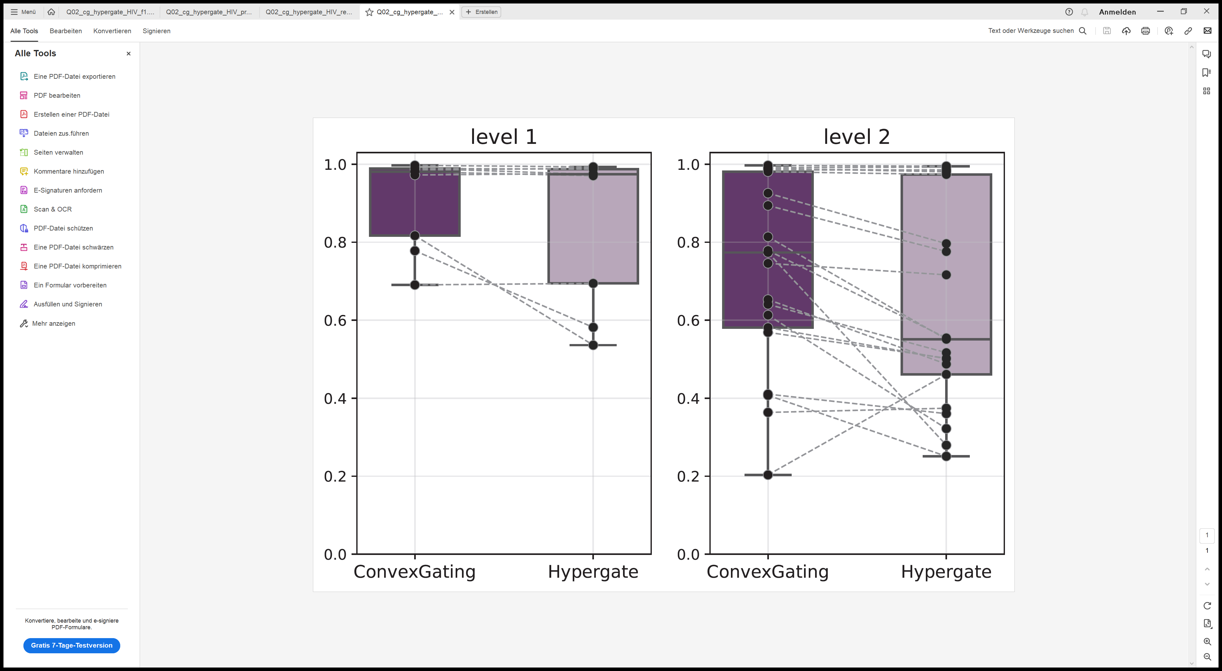
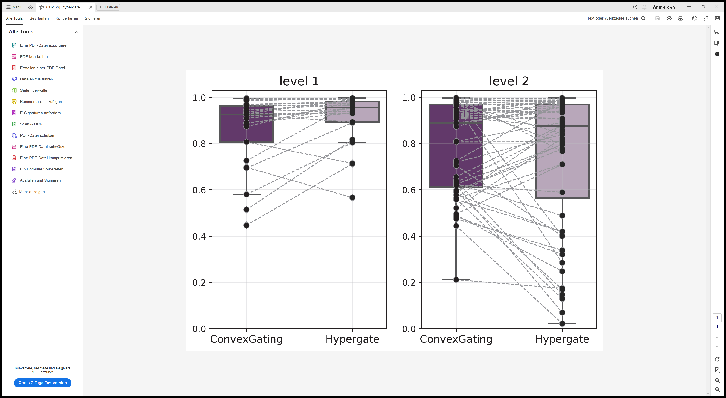
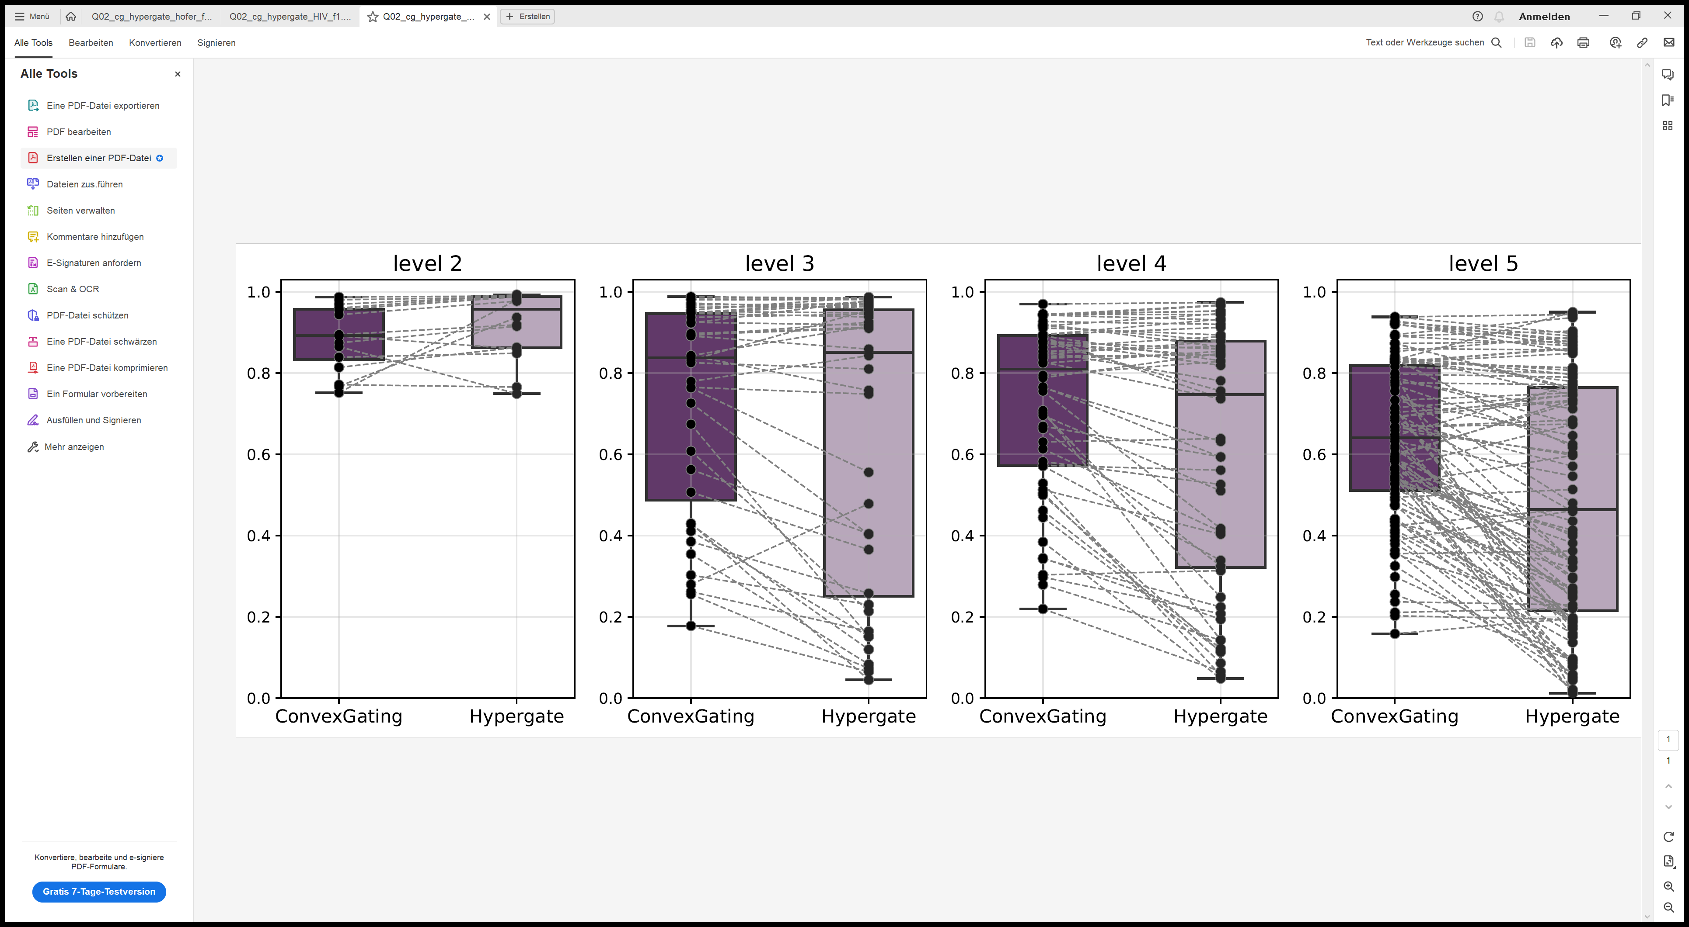
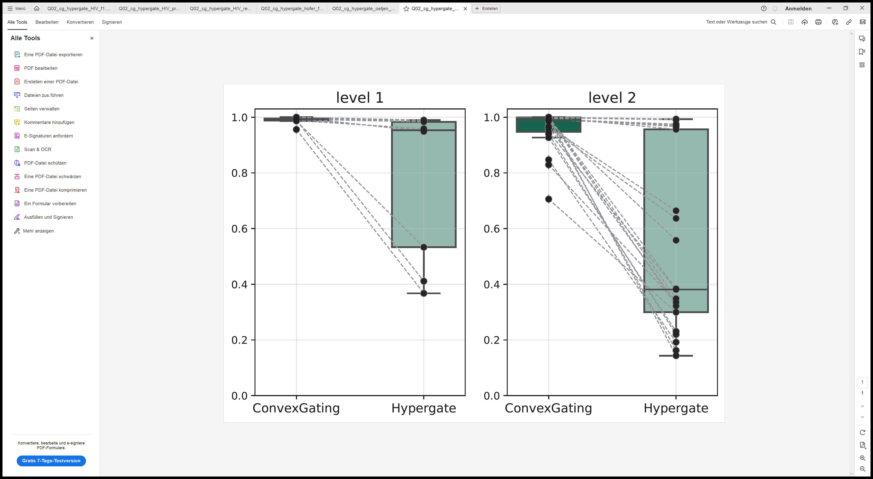
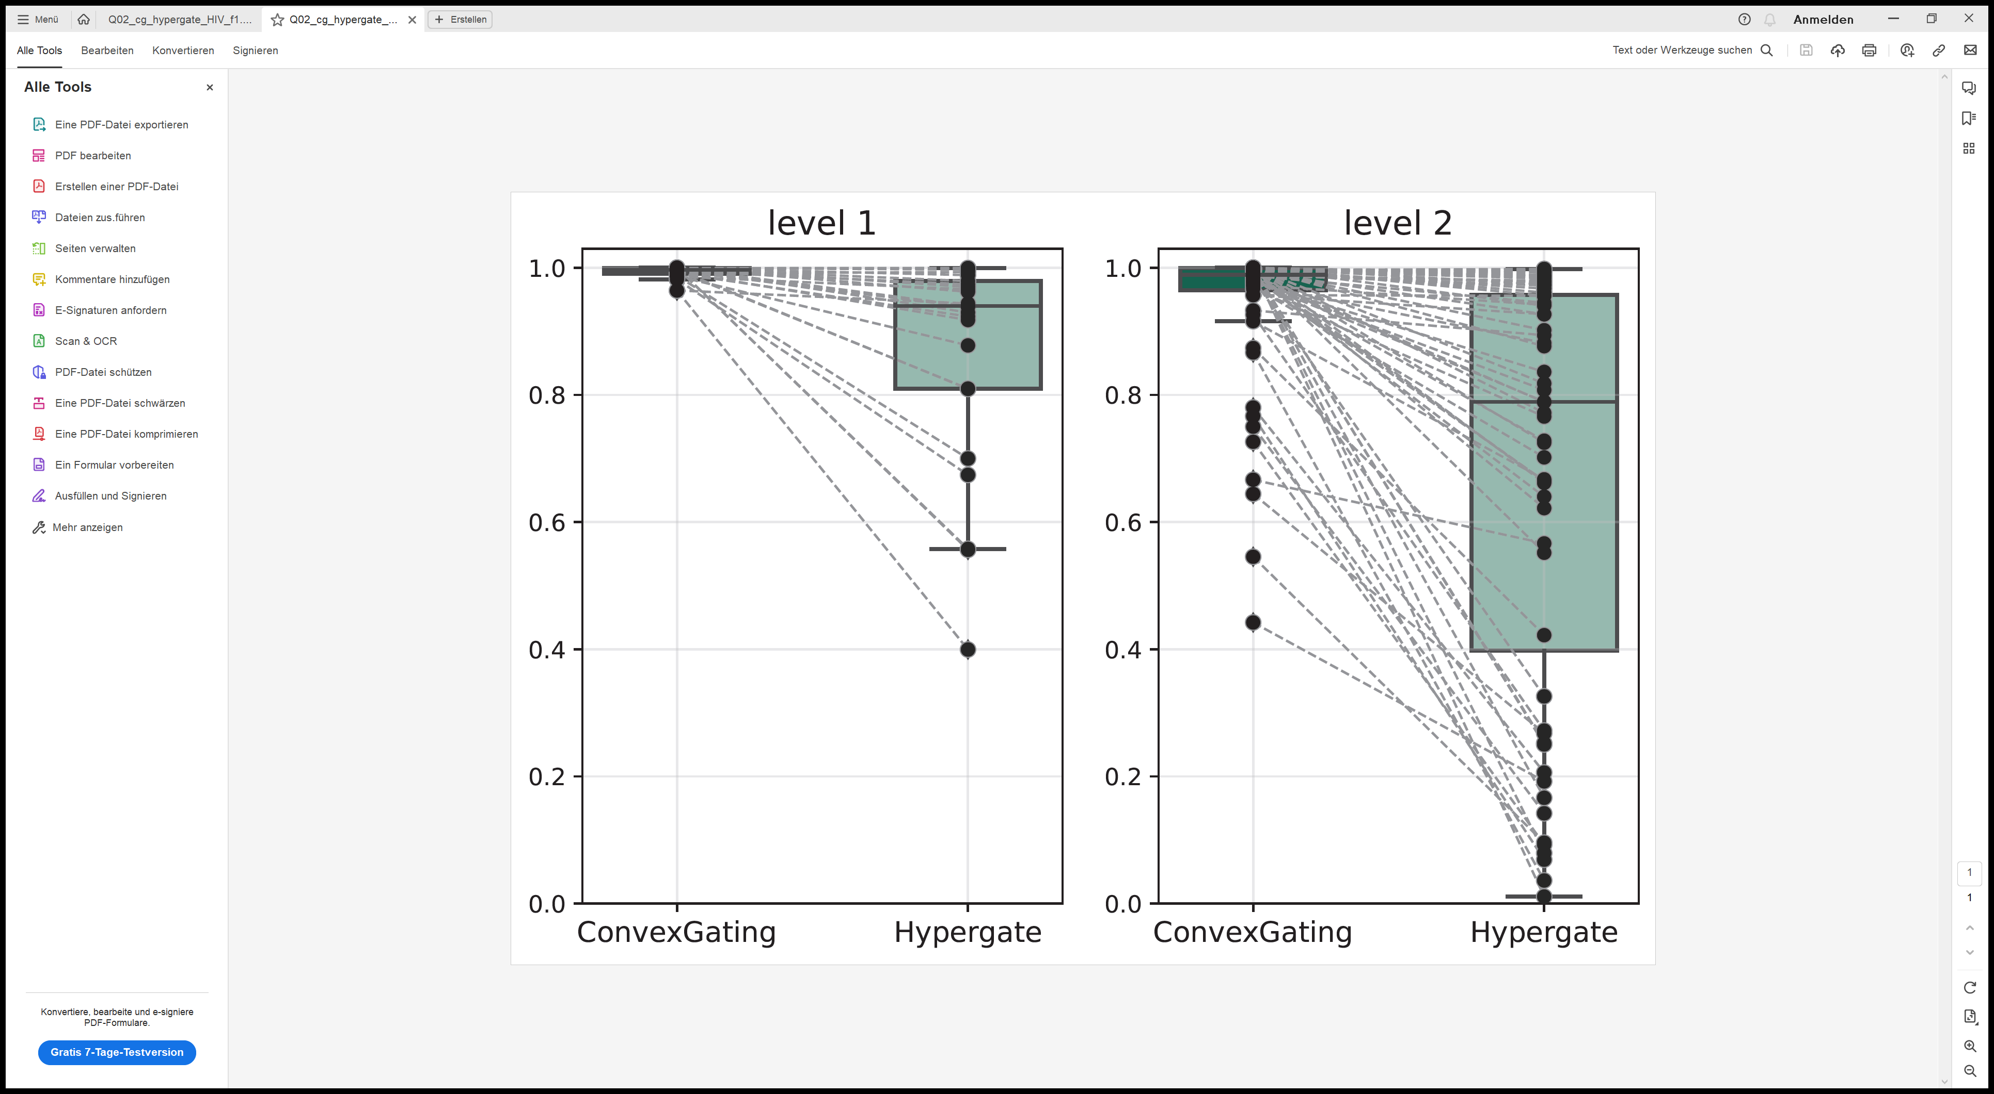
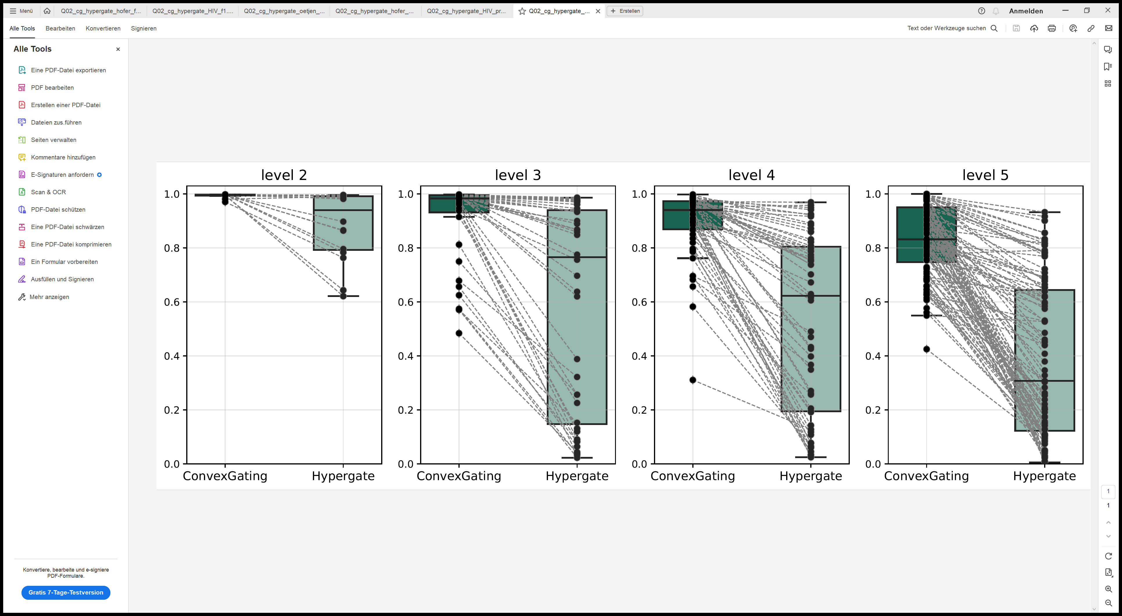
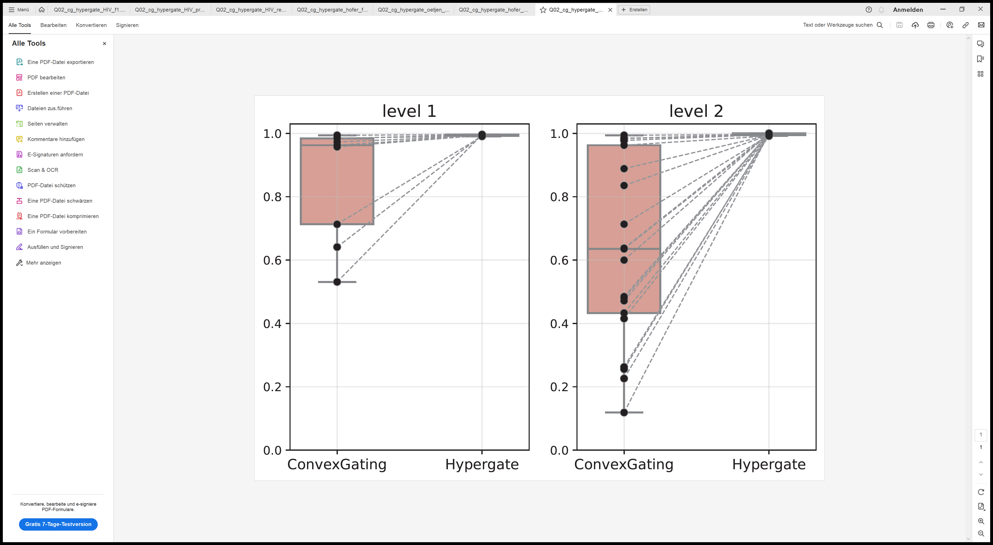
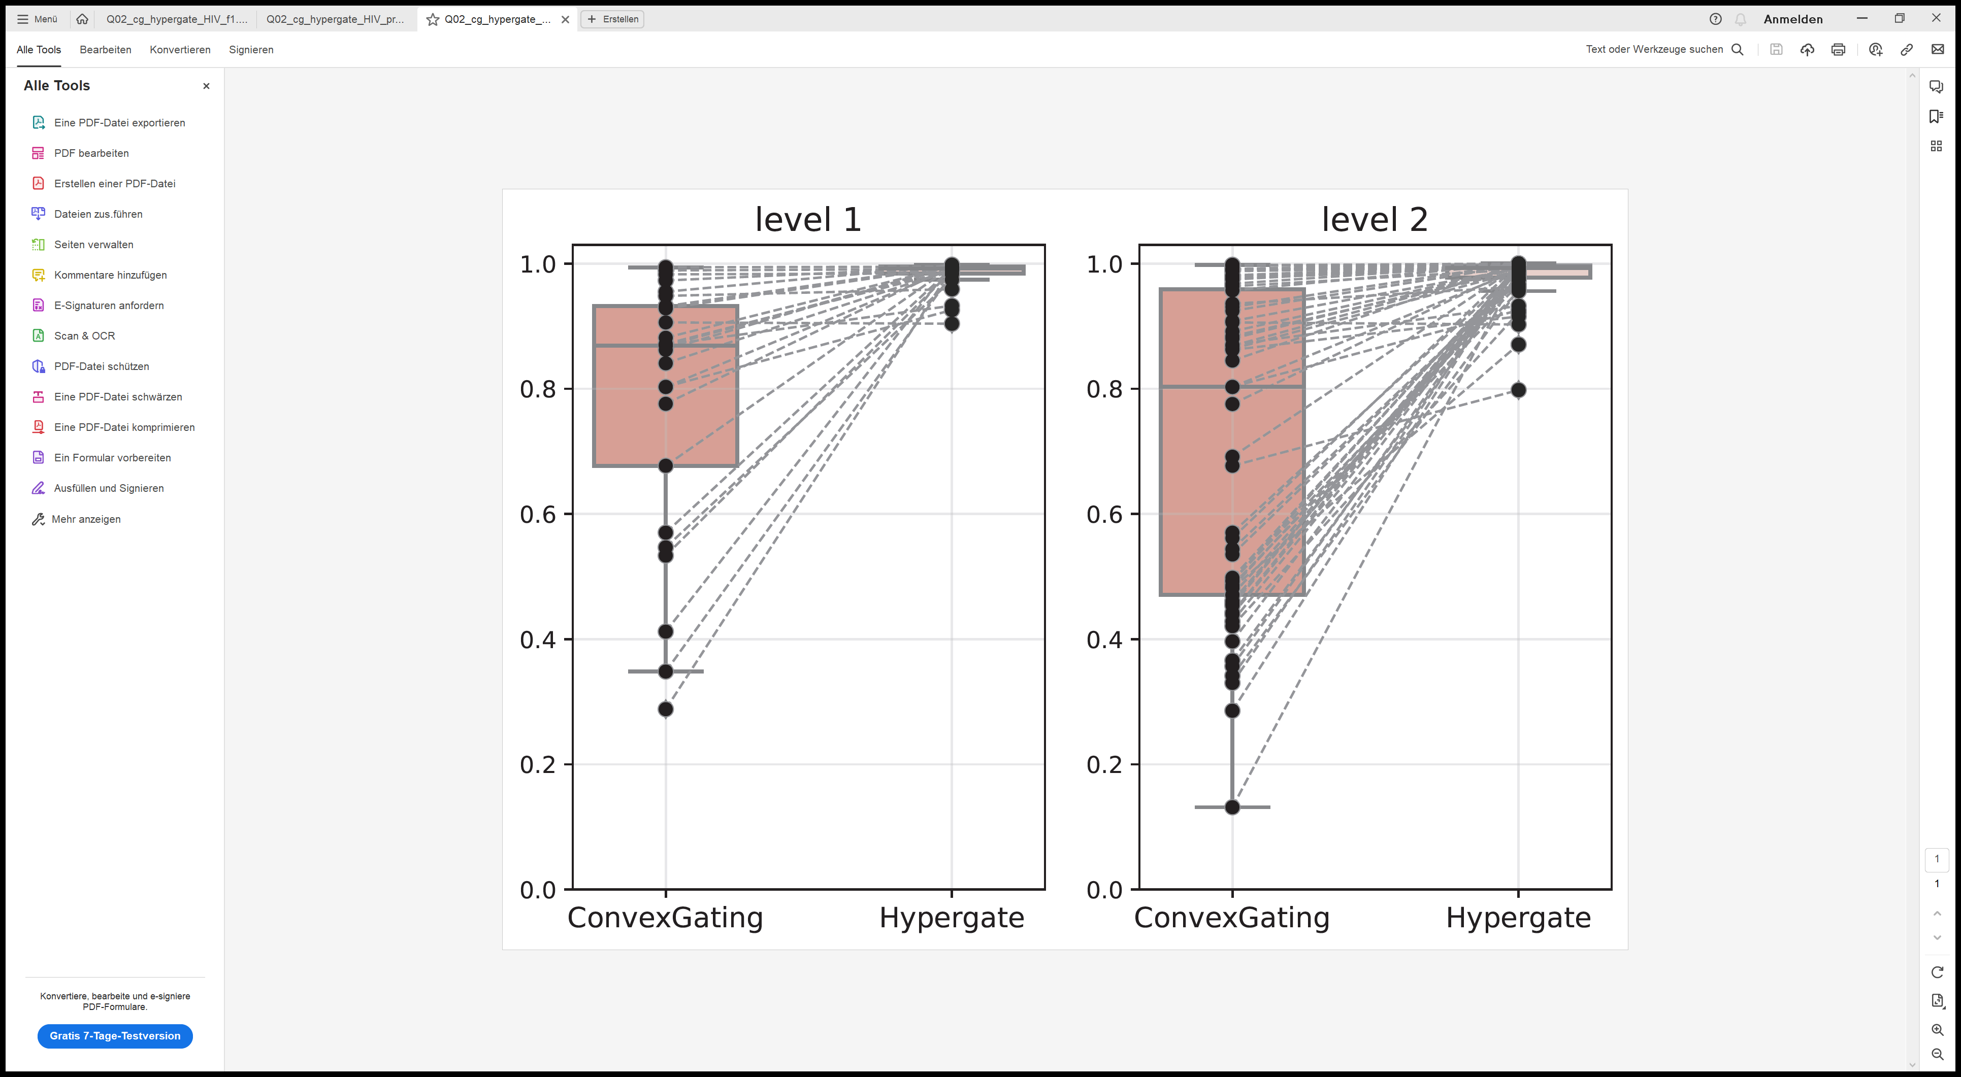
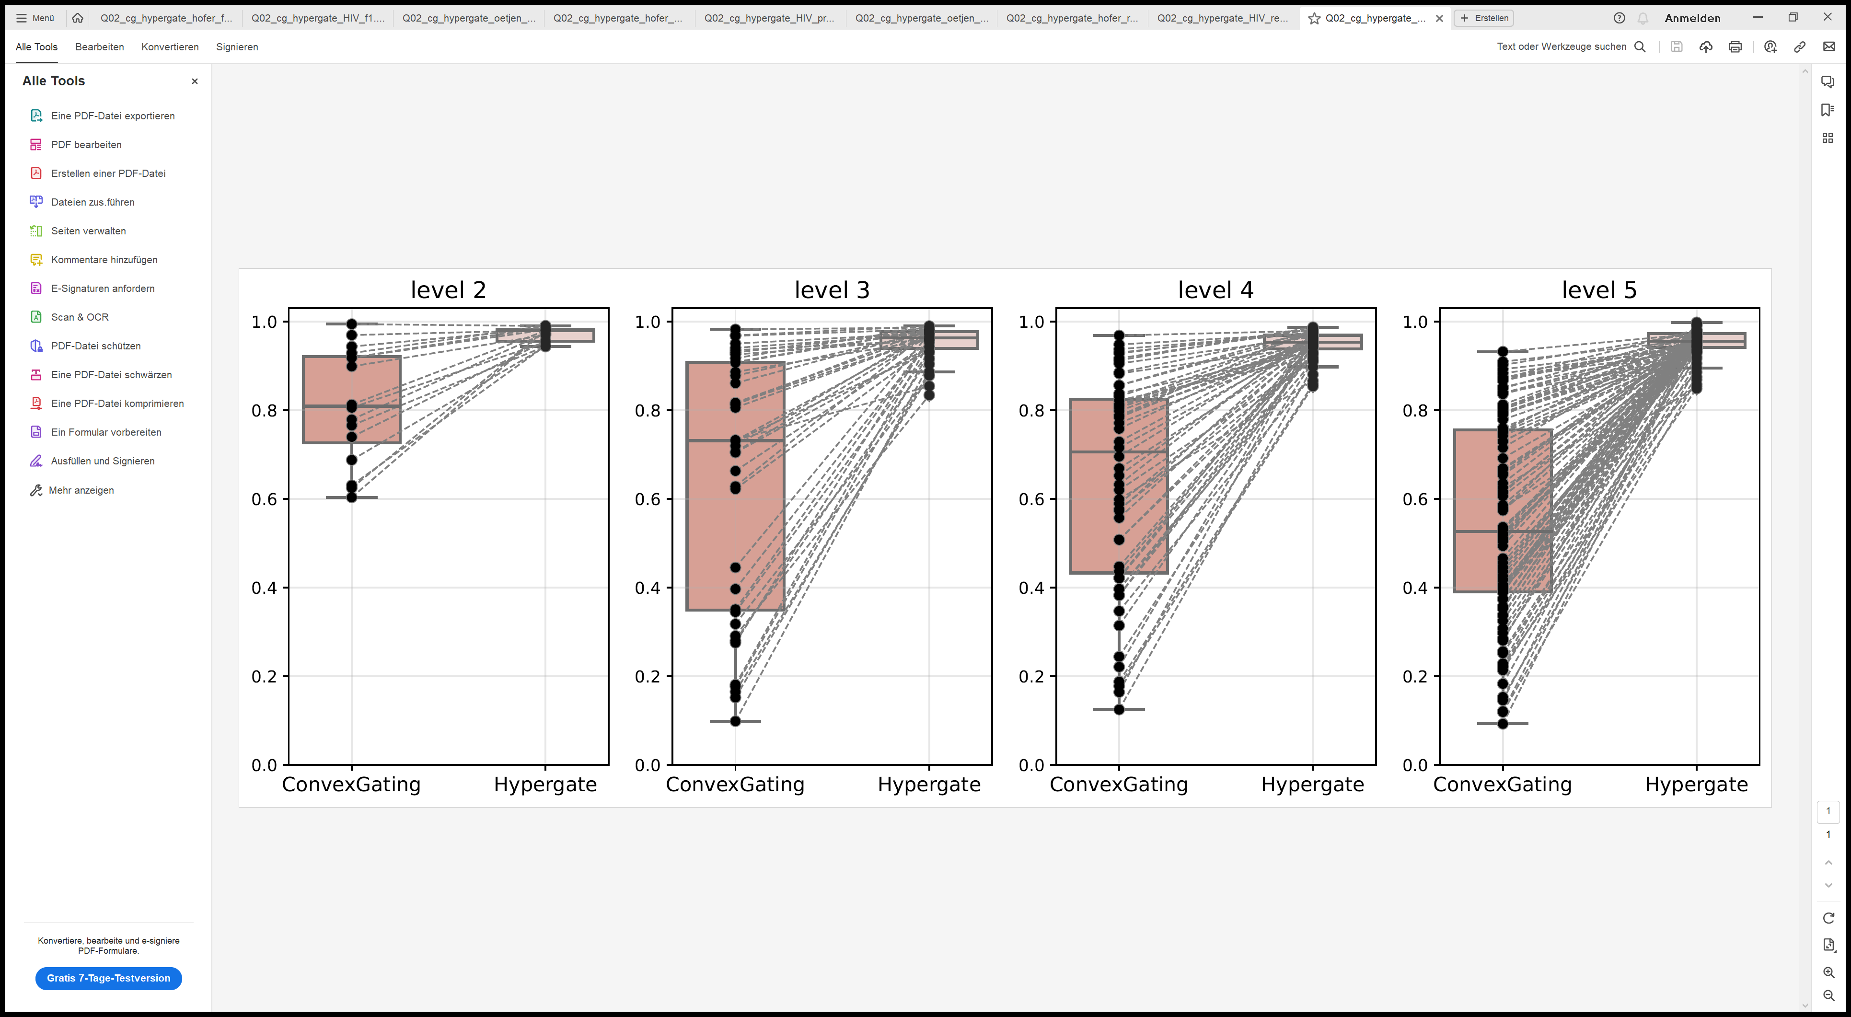
A
FACS (Hofer)
B
FACS (HIV)
C
CyTOF (Oetjen)

Slide 3
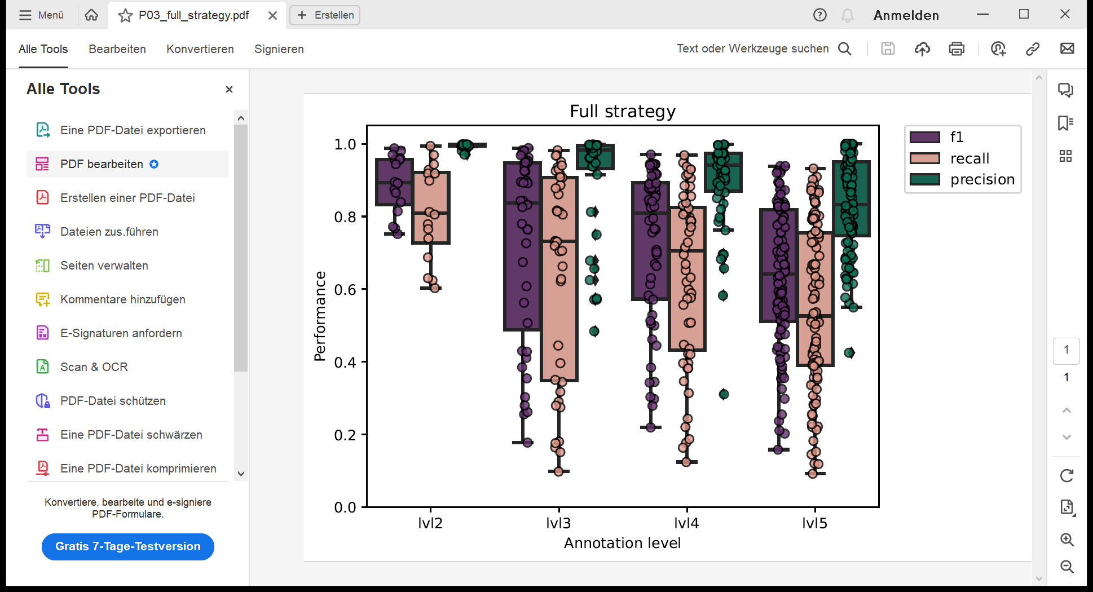
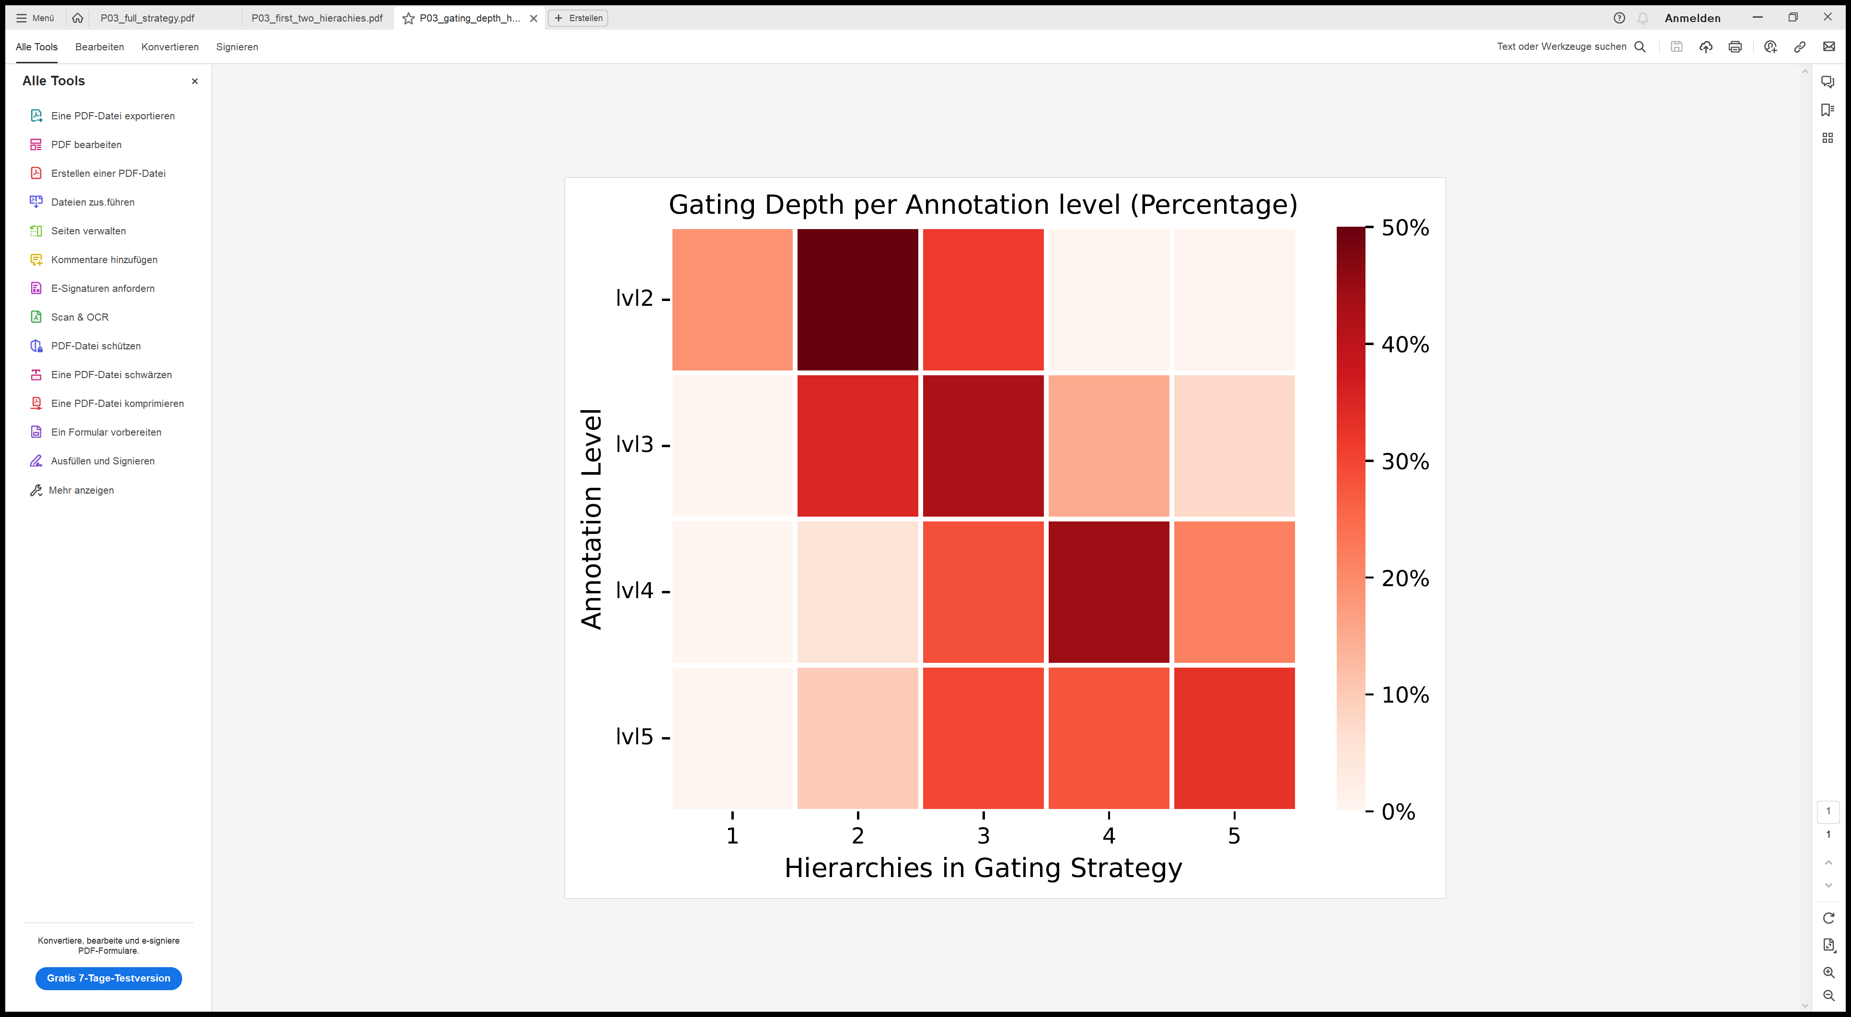
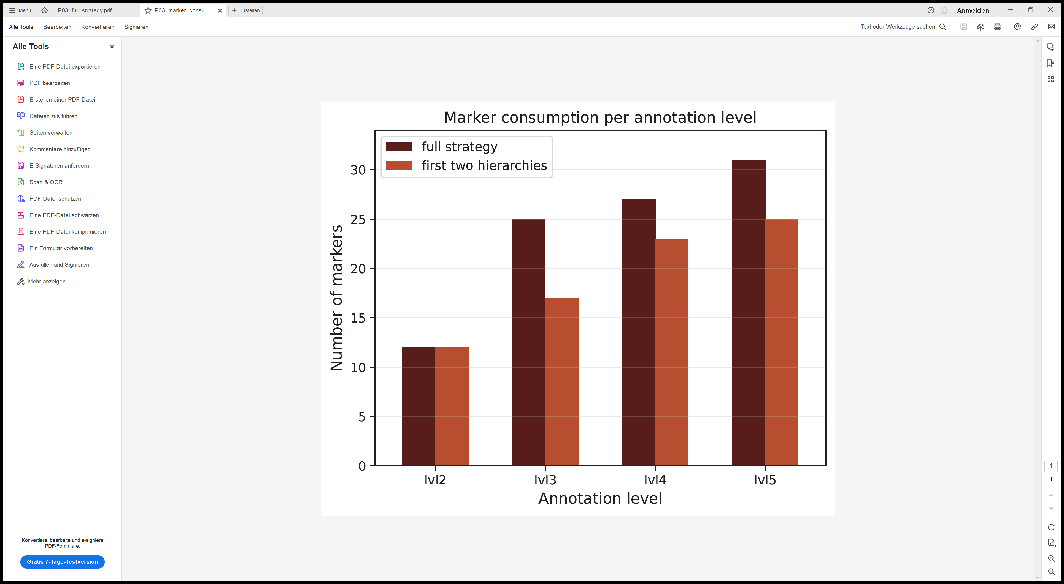
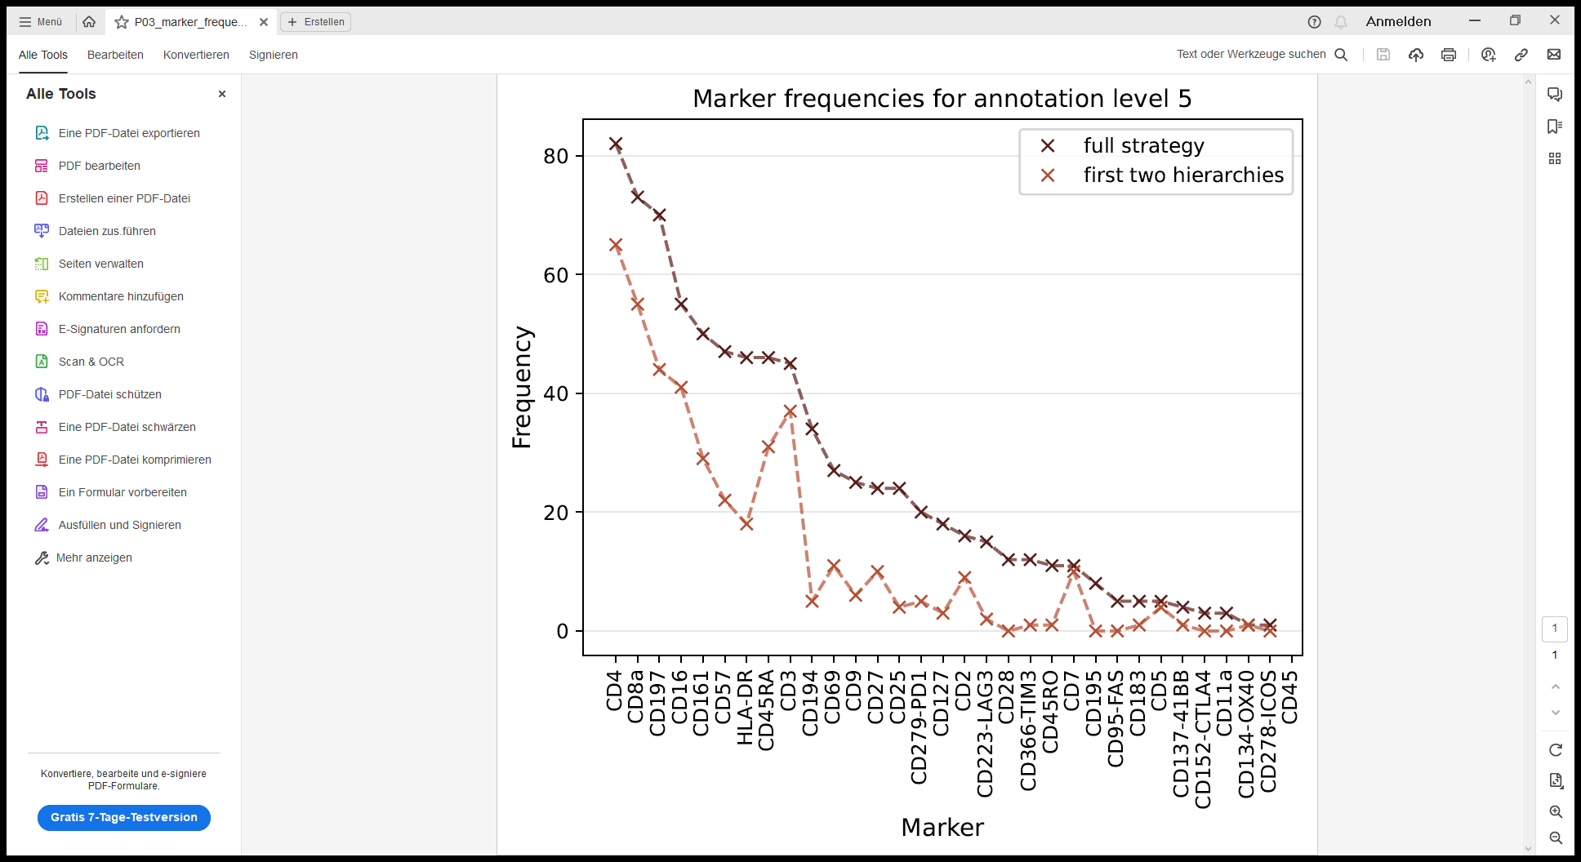
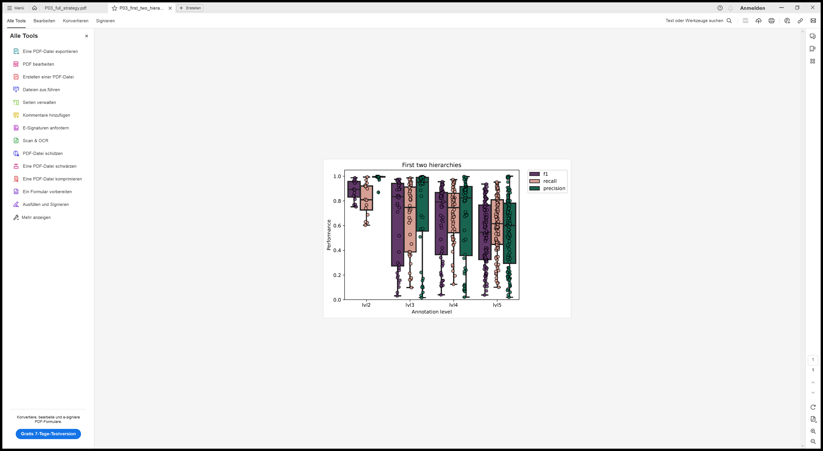
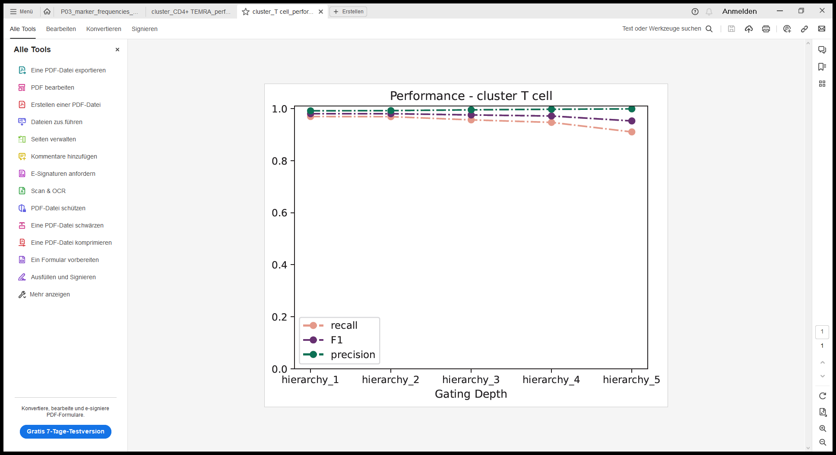
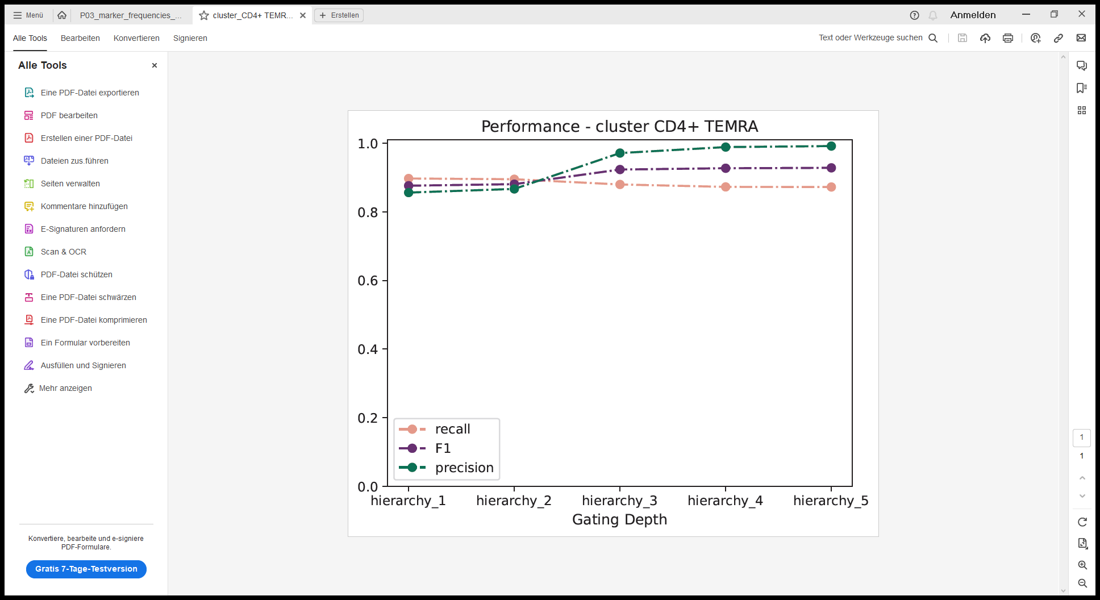
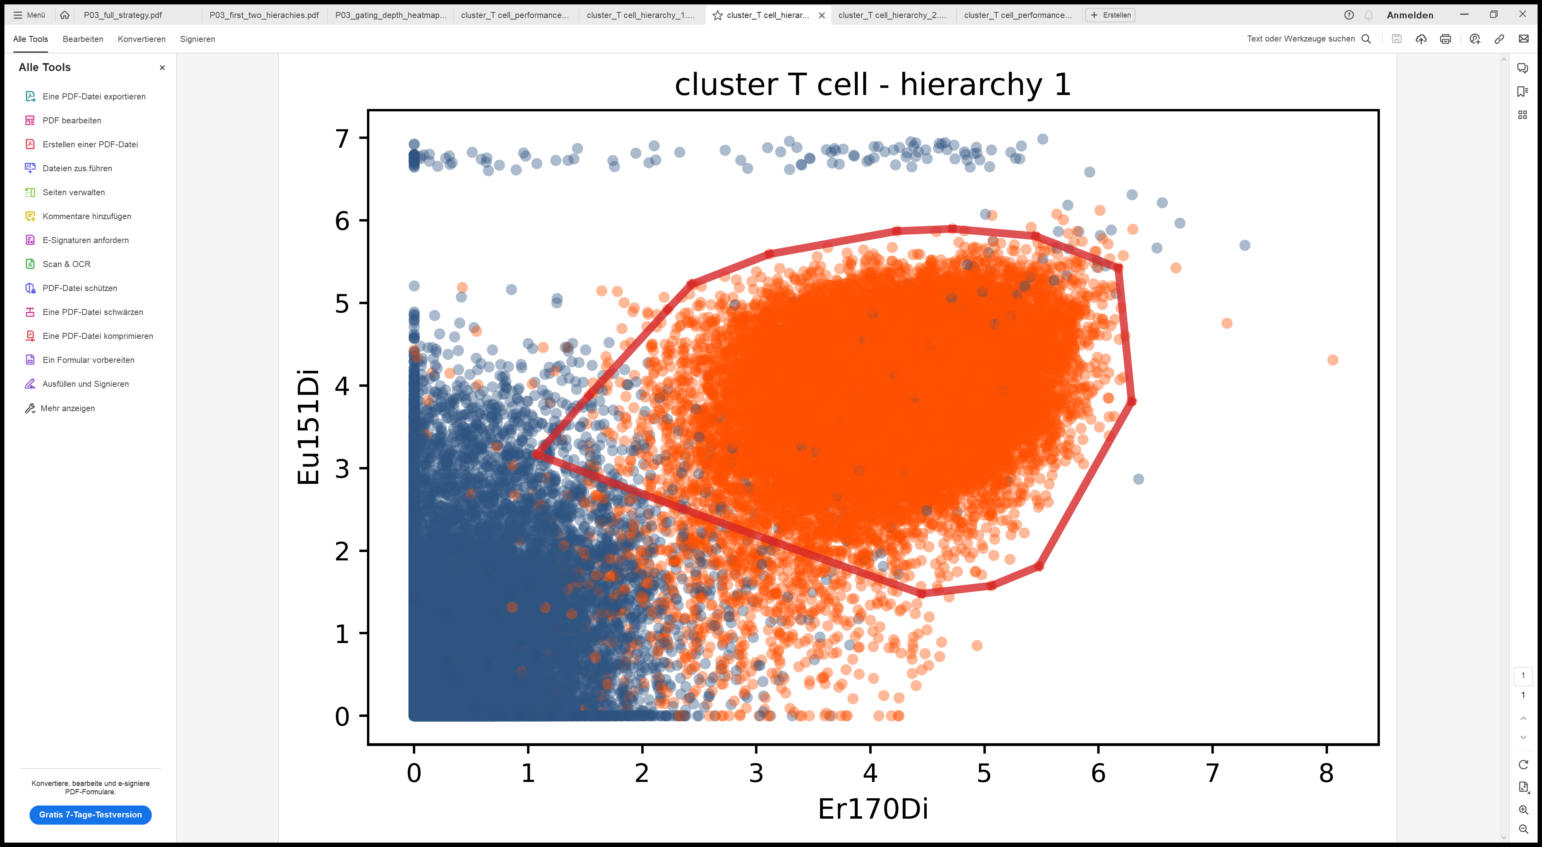
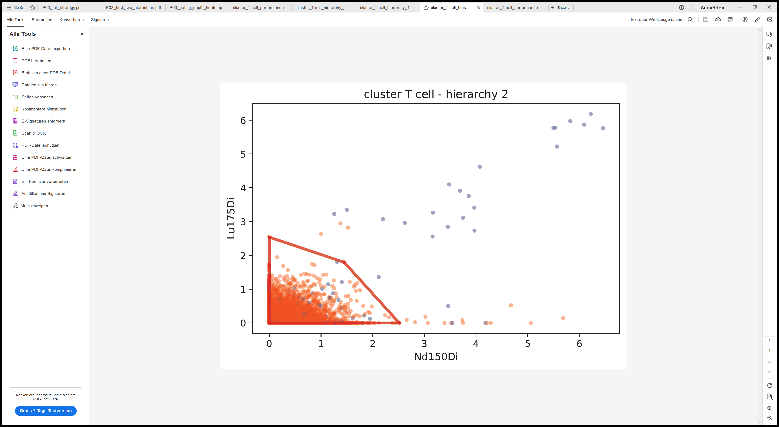
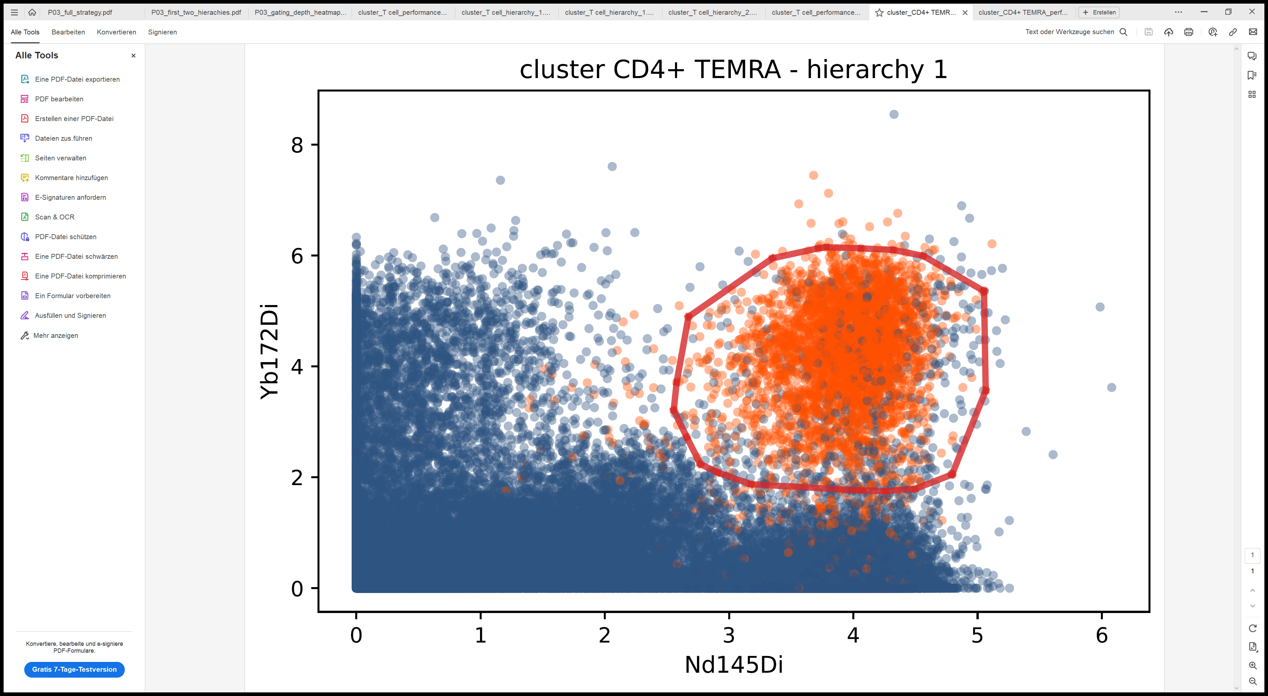
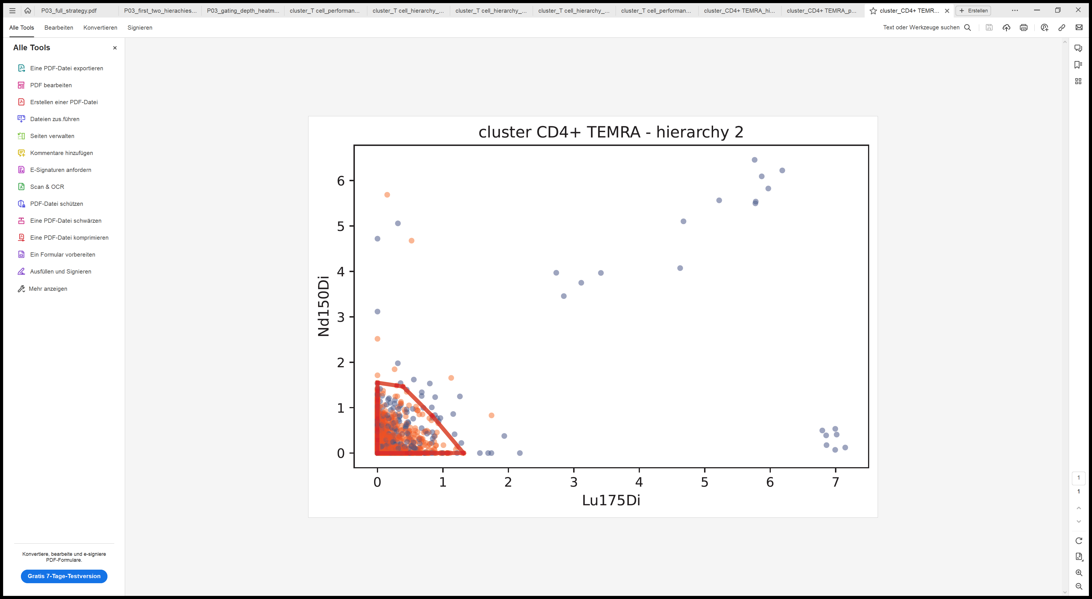
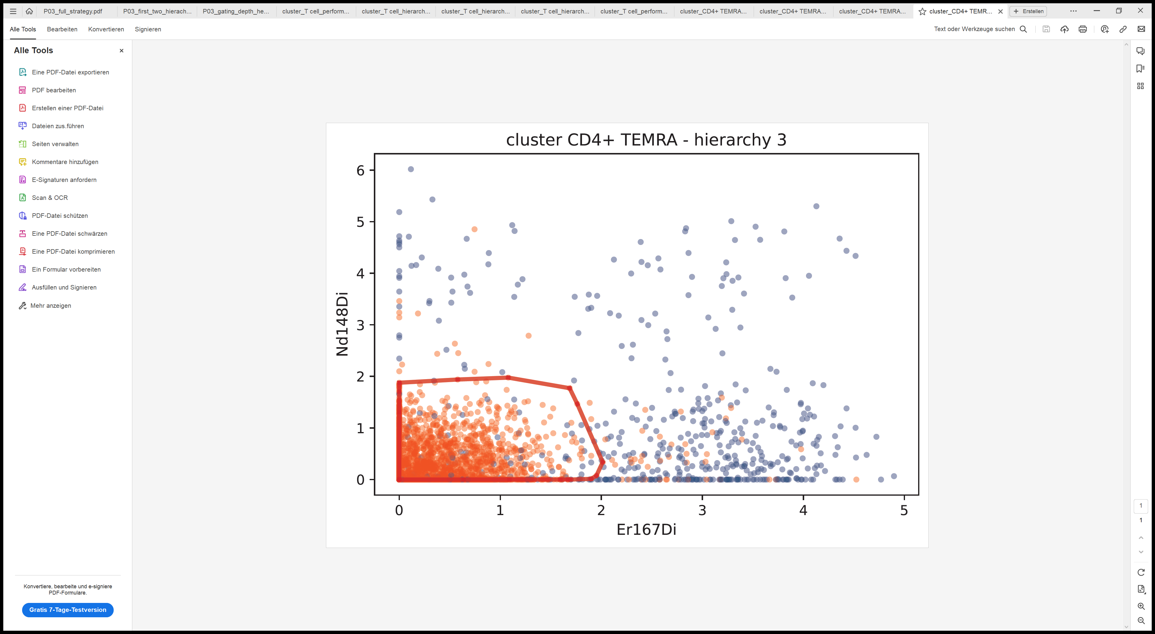
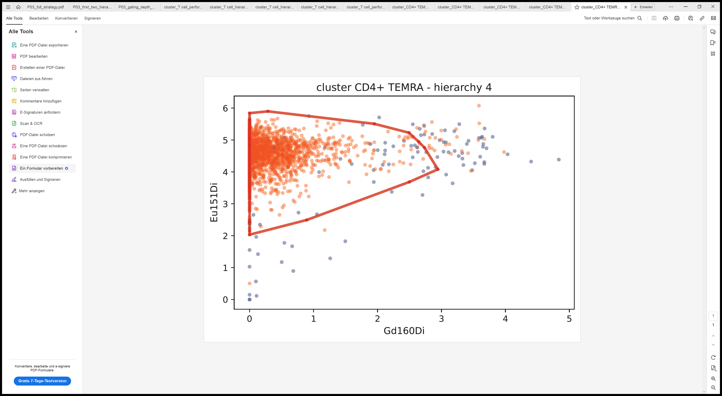

A
B
C
D
E
F
Sample A
Level 2 – T Cells
G
Sample A
Level 5 – CD4+ TEMRA Cells

Slide 4




A
B
C
D
E
F
Level 2 – T Cells
Sample A
CD2
CD223-LAG3
CD3
CD134 – OX40
G
Sample A
Level 5 – CD4+ TEMRA Cells
CD57
CD223-LAG3
CD16
CD2
HLA-DR
CD4
CD223-LAG3
CD27
CD28
CD28

Slide 5




















A
CD4+ compartment
CD8+ compartment
B
C
F
D
lokal: ~\projects\gating\reproducibility\Figure_6
~\projects\gating\Paper\covid
Cluster: /work/users/mh823zote/projects/gating/data/covid
E

Slide 6
























A
Panelsize
B
0
50
100
150
200
CITEseq
full
CITEseq 192
CyTOF
full
CyTOF 40
full
FACS 15
CITEseq & CyTOF 29
CITEseq
FACS & CyTOF 8
FACS
CITEseq & FACS 10
minimal 4
CyTOF C7
CyTOF C8
CITEseq
FACS
CyTOF C7
CyTOF C8
CITEseq
FACS
f
f
f
f
f
f
f
f
CyTOF
FACS
M
f
full panel
CyTOF & FACS
M
minimal panel
FACS
CITEseq & CyTOF
CITEseq & FACS
(CD3,CD4, CD8, CD16)
C
CyTOF CD4
D
CyTOF CD8
E
CITEseq CD4
F
CITEseq CD8
G
FACS CD4
H
FACS CD8

Slide 7
Supplement

Slide 8




A
B
C
D

Slide 9


















A
FACS (Hofer)
B
FACS (HIV)
C
CyTOF (Oetjen)
Linear SVM
A
FACS (Hofer)
B
FACS (HIV)
C
CyTOF (Oetjen)
RBF SVM

Slide 10
Archive

Slide 11


















CyTOF
A
B
C
F
D
E
lokal: ~\projects\gating\Paper\covid
Cluster: /work/users/mh823zote/projects/gating/data/covid

Slide 12


CyTOF
A
B
C
F
Full Panel Performance
D
metric
C7
C8
C25
C26
CD4+
CD8+
E
lokal: ~\projects\gating\Paper\covid
Cluster: /work/users/mh823zote/projects/gating/data/covid

Slide 13
CyTOF
A
CD4+ compartment
CD8+ compartment
B
C
F
Full Panel Performance
D
metric
C7
C8
C25
C26
CD4+
CD8+
E
lokal: ~\projects\gating\Paper\covid
Cluster: /work/users/mh823zote/projects/gating/data/covid

Slide 14
Full Panel Performance
metric
C7
C8
C25
C26
CD4+
CD8+

Slide 15

























Hofer
HIV
Oetjen
level 1
level 2
level 1
level 2
level 2
level 3
level 4
level 5
F1
level 1
level 2
level 1
level 2
level 2
level 3
level 4
level 5
precision
level 1
level 2
level 1
level 2
level 2
level 3
level 4
level 5
recall

Slide 16















Oetjen
HIV
Hofer
lv4
lv2
lv5
lv3
lv4
lv2
lv3
lv5
lv1
lv2
lv1
lv2
lv1
lv2
lv1
lv2

Slide 17
Sample A

Slide 18




Benchmarking
1.0
0.8
1
0.6
0.4
0.2
2
level 1
level 2
level 1
level 2
level 2
level 3
level 4
level 5
0.0
FACS Hofer (1)
FACS HIV (2)
CyTOF Oetjen (3)
3

Slide 19












24
$$G$$
12
hierarchy 1
B
feature 4
$$G^{}$$
feature 4
$$G$$
feature 4
$$G^{}$$
feature 1
Convex Hull
feature 1
feature 1
B
$$G^{final}$$
$$H_{4}$$
$$w_{5}$$
$$w_{1}$$
$$H_{1}$$
$$w_{4}$$
$$w_{2}$$
$$G$$
feature j
$$H_{2}$$
$$H_{3}$$
$$w_{3}$$
feature i

Slide 20

1.0
0.8
0.6
0.4
0.2
KR
KW
MF
01
03
05
07
09
A
B
C
H
J
O
T
U
0.0
FACS Hofer
FACS HIV
CyTOF Oetjen

Slide 21



CyTOF

Slide 22


FACS
FACS
CyTOF

Slide 23






A
Hofer (FACS)
B
HIV (FACS)
C
Oetjen (FACS)

Slide 24









Slide 25















Bridge CyTOF - CITEseq
A
B
CD16+ CD4+ T cell
CD16+ CD8+ T cell
metric
j
panel
f – full panel
j – joint panel
m – minimal panel
full panel CITEseq
CyTOF
CITEseq
CyTOF
CITEseq
j
full panel CyTOF
panel
joint panel CITEseq & CyTOF
f
j
f
j
f
j
m
f
j
f
j
f
j
m
m minimal panel (CD3, CD4, CD8, CD16)
C7
C8
CD4+
C25
C26
CD8+
cluster
C
joint panel - CITEseq – CD4
D
joint panel - CITEseq – CD8
E
joint panel - CyTOF – C7
F
joint panel - CyTOF – C8
G
joint panel - CyTOF – C25
H
joint panel - CyTOF – C26
Cluster: /work/users/mh823zote/projects/gating/data/CITEseq_Covid
lokal: ~\projects\gating\Paper\covid
Cluster: /work/users/mh823zote/projects/gating/data/covid

Slide 26

Bridge CyTOF - CITEseq
A
B
CD16+ CD4+ T cell
CD16+ CD8+ T cell
metric
panel
f – full panel
j – joint panel
m – minimal panel
CyTOF
CITEseq
CyTOF
CITEseq
f
j
f
j
f
j
m
f
j
f
j
f
j
panel
C7
C8
CD4+
C25
C26
CD8+
m
cluster
C
joint panel - CITEseq – CD4
D
joint panel - CITEseq – CD8
E
joint panel - CyTOF – C7
F
joint panel - CyTOF – C8
G
joint panel - CyTOF – C25
H
joint panel - CyTOF – C26
Cluster: /work/users/mh823zote/projects/gating/data/CITEseq_Covid
lokal: ~\projects\gating\Paper\covid
Cluster: /work/users/mh823zote/projects/gating/data/covid

Slide 27
A
Panels
CITEseq
CITEseq
CyTOF
FACS
CyTOF
FACS
M
FACS

Slide 28












A
Panels
B
CD16+CD4+ T cells
CD16+CD8+ T cells
CITEseq
CITEseq
CyTOF
FACS
metric
CyTOF
FACS
M
FACS
CyTOF
CITEseq
FACS
CyTOF
CITEseq
FACS
f
f
f
f
f
f
f
f
C
D
E
F
G
H
C
CITEseq CD4
G
D
FACS CD4
CITEseq CD8
H
E
FACS CD8
CyTOF CD4 – C8
F
CyTOF CD8 – C25

Slide 29
Bridge CyTOF – CITEseq - FACS
A
C
D
CD16+CD8+ T cells
CD16+CD4+ T cells
C7
C8
C25
C26
f
full panel
CITEseq
CyTOF
CITEseq & CyTOF
CyTOF
FACS
CyTOF & FACS
CITEseq & FACS
M
minimal panel
CITEseq
FACS
M
metric
FACS
Panelsize
CyTOF
CyTOF
CITEseq
FACS
CyTOF
CyTOF
CITEseq
FACS
0
50
100
150
200
f
f
f
f
f
f
f
f
full
CITEseq 192
CyTOF CD4 C8
full
CyTOF 40
full
FACS 15
CITEseq & CyTOF 29
FACS & CyTOF 8
CITEseq & FACS 10
minimal 4
E
CyTOF CD8 C25
B
F
CITEseq CD4
G
CITEseq CD4
H
FACS CD4
I
FACS CD8

Slide 30
A
Panelsize
B
CD16+CD4+ T cells
CD16+CD8+ T cells
0
50
100
150
200
C7
C8
C25
C26
CITEseq
full
CITEseq 192
CyTOF
full
CyTOF 40
full
FACS 15
CITEseq & CyTOF 29
CITEseq
FACS & CyTOF 8
FACS
CITEseq & FACS 10
minimal 4
CyTOF
CITEseq
FACS
CyTOF
CyTOF
CITEseq
FACS
f
f
f
f
f
f
f
f
CyTOF
FACS
M
f
full panel
CyTOF & FACS
M
minimal panel
FACS
CITEseq & CyTOF
CITEseq & FACS
(CD3,CD4, CD8, CD16)
C
CyTOF CD4 C8
D
CyTOF CD8 C25
E
CITEseq CD4
F
CITEseq CD8
G
FACS CD4
H
FACS CD8

Slide 31
A
Panelsize
B
CD16+CD4+ T cells
CD16+CD8+ T cells
0
50
100
150
200
C7
C8
C25
C26
CITEseq
full
CITEseq 192
CyTOF
full
CyTOF 40
full
FACS 15
CITEseq & CyTOF 29
CITEseq
FACS & CyTOF 8
FACS
CITEseq & FACS 10
minimal 4
CyTOF
CITEseq
FACS
CyTOF
CyTOF
CITEseq
FACS
f
f
f
f
f
f
f
f
CyTOF
FACS
M
f
full panel
CyTOF & FACS
M
minimal panel
FACS
CITEseq & CyTOF
CITEseq & FACS
(CD3,CD4, CD8, CD16)
C
CyTOF CD4 C8
D
CyTOF CD8 C25
E
CITEseq CD4
F
CITEseq CD8
G
FACS CD4
H
FACS CD8

Slide 32
Backup Slides

Slide 33







full panel - CITEseq – CD4
full panel - CITEseq – CD8
minimal panel - CITEseq – CD4
minimal panel - CITEseq – CD8

Slide 34



Slide 35
CyTOF
CITEseq
CD16+ CD4+ T cell
CD16+ CD8+ T cell
metric
panel
f – full panel
j – joint panel
m – minimal panel
CyTOF
CITEseq
CyTOF
CITEseq
f
j
f
j
f
j
m
f
j
f
j
f
j
m
panel
panel
CD4+
cluster
C25
C26
CD8+
cluster
C7
C8
CD16+ CD4+ T cell
CD16+ CD8+ T cell
metric
panel
f – full panel
j – joint panel
m – minimal panel
CyTOF
CITEseq
CyTOF
CITEseq
f
j
f
j
f
j
m
panel
CD4+
f
j
f
j
f
j
m
cluster
C7
C8
C25
C26
CD8+

